Slide 1

🔐 Phishing URL Detection using Machine Learning Fake or Safe? Let AI Decide
B. Aarthika - 24N81A6255
Ch. Bhavana - 24N81A6216
B. Bhavitha -24N81A6215
V. Mounika - 24N81A6218
V. Likitha - 24N81A6241

Slide 2

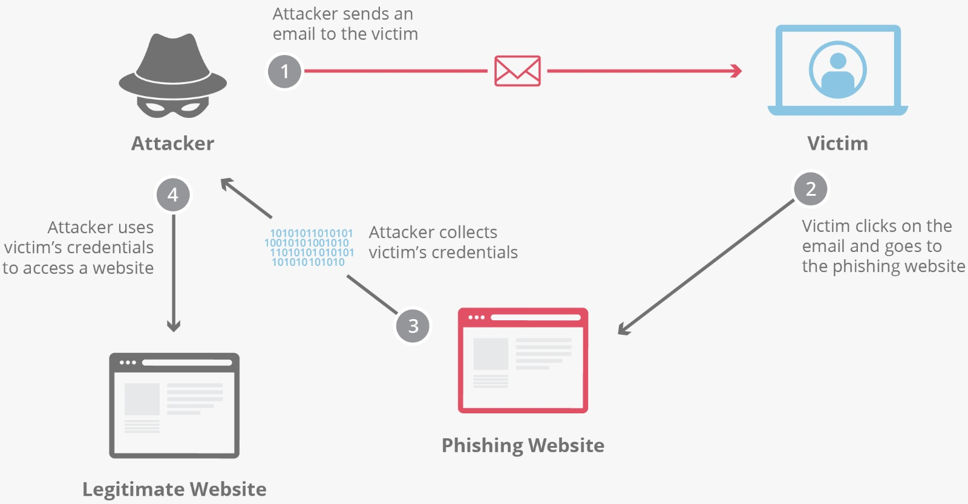
Introduction:
Phishing is one of the most common and dangerous cyberattacks used to steal sensitive information such as usernames, passwords, and financial details. Attackers create fake websites or URLs that look similar to legitimate ones to trick users into providing their personal data.
With the rapid growth of internet usage, identifying such malicious links manually has become difficult and time-consuming. Therefore, there is a need for an automated system that can quickly and accurately detect phishing URLs.
This project presents a solution using Machine Learning, where a model is trained to analyze different characteristics of a URL and classify it as either legitimate or phishing. By using intelligent algorithms, the system helps improve cyber security and protects users from online threats.

Slide 3

Objective:
To develop a system that can detect phishing URLs automatically.
To classify URLs as Legitimate or Phishing using Machine Learning.
To reduce the risk of cyber attacks and online fraud.
To provide a fast and user-friendly interface for real-time detection.
To improve awareness and security for internet users.

Slide 4
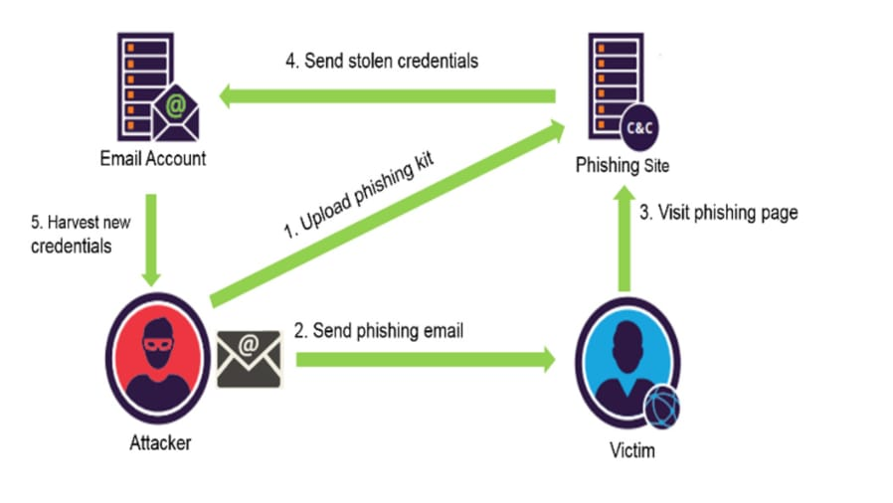
Methodology:
1. Data Collection Collected phishing dataset containing URLs and labels. 2. Data Preprocessing Converted text labels into numerical values Removed missing or invalid data 3. Feature Extraction Extracted features like: URL length Number of dots Presence of special symbols (@, -) HTTPS usage 4. Model Training Used Random Forest algorithm Trained model on dataset 5. Model Evaluation Tested accuracy using test data Achieved ~96% accuracy 6. User Interface Development Built interface using Streamlit Enabled real-time URL checking

Slide 5
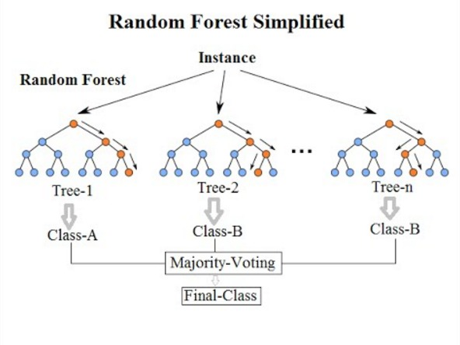
Algorithm Used :
Algorithm: Random Forest.
The project uses the Random Forest Algorithm, a powerful Machine Learning technique.
It is an ensemble learning method that combines multiple decision trees.
Each tree makes a prediction, and the final result is decided by majority voting.
It improves accuracy and reduces overfitting compared to a single decision tree.

Slide 6
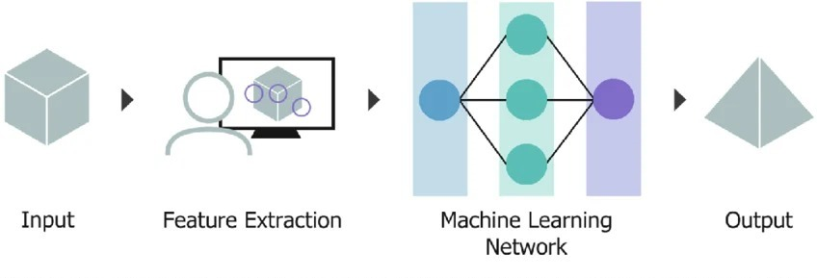
System Architecture:
User → Input URL → Feature Extraction → ML Model → Output

Slide 7
Future Scope :
Integrate with real-time browser extensions.
Use advanced deep learning models for better accuracy.
Add live blacklist and threat intelligence APIs.
Enhance UI with more detailed explanations.

Slide 8

Conclusion :
The project successfully developed a system to detect phishing URLs using Machine Learning.
The Random Forest algorithm provided high accuracy (~96%) in classification.
The system can quickly identify whether a URL is safe or phishing.
A simple user interface was created using Streamlit for real-time detection.
This project helps improve cybersecurity awareness and protection against online threats.

Slide 9


